Slide 1
UseR! 2021 Conducting Effective User Tests for Shiny Dashboards
Maria Grycuk

Slide 2
Agenda
What I will be talking about and why I believe is it important
Good practices

Slide 3
Include users into your development process as soon as possible

Slide 4

How to organize a 1:1 user test meeting:
Ask the user about his/her daily work
Ask the user to perform actions in the application
Gather general feedback (User Interview)

Slide 5
How to organize a 1:1 user test meeting:
Ask the user about his/her daily work
Ask the user to perform actions in the application
Gather general feedback (User Interview)

Slide 6
How to organize a 1:1 user test meeting:
Ask the user about his/her daily work
Ask the user to perform actions in the application
Gather general feedback (User Interview)

Slide 7
How to organize a 1:1 user test meeting:
Ask the user about his/her daily work
Ask the user to perform actions in the application
Gather general feedback (User Interview)

Slide 8
Good practices

Slide 9
Good practices
Do not wait until the product is “good enough”
Limit the explanation to the minimum, do not describe anything without being asked
Ask users to perform business actions
Ask them to speak aloud about their thinking process and expectations
When asking about the general feedback ask open, not leading questions

Slide 10



Case study
POC Final app
Project Leader Project Leader 3 developers 3 developers 2 weeks 3 months
Stats:
151 pull requests merged
83 issues closed

Slide 11
Good practices
Do not wait until the product is “good enough”
Limit the explanation to the minimum, do not describe anything without being asked
Ask users to perform business actions
Ask them to speak aloud about their thinking process and expectations
When asking about the general feedback ask open, not leading questions

Slide 12
Good practices
Do not wait until the product is “good enough”
Limit the explanation to the minimum, do not describe anything without being asked
Ask users to perform business actions
Ask them to speak aloud about their thinking process and expectations
When asking about the general feedback ask open, not leading questions

Slide 13
Good practices
Do not wait until the product is “good enough”
Limit the explanation to the minimum, do not describe anything without being asked
Ask users to perform business actions
Ask them to speak aloud about their thinking process and expectations
When asking about the general feedback ask open, not leading questions

Slide 14
Good practices
Do not wait until the product is “good enough”
Limit the explanation to the minimum, do not describe anything without being asked
Ask users to perform business actions
Ask them to speak aloud about their thinking process and expectations
When asking about the general feedback ask open, not leading questions

Slide 15

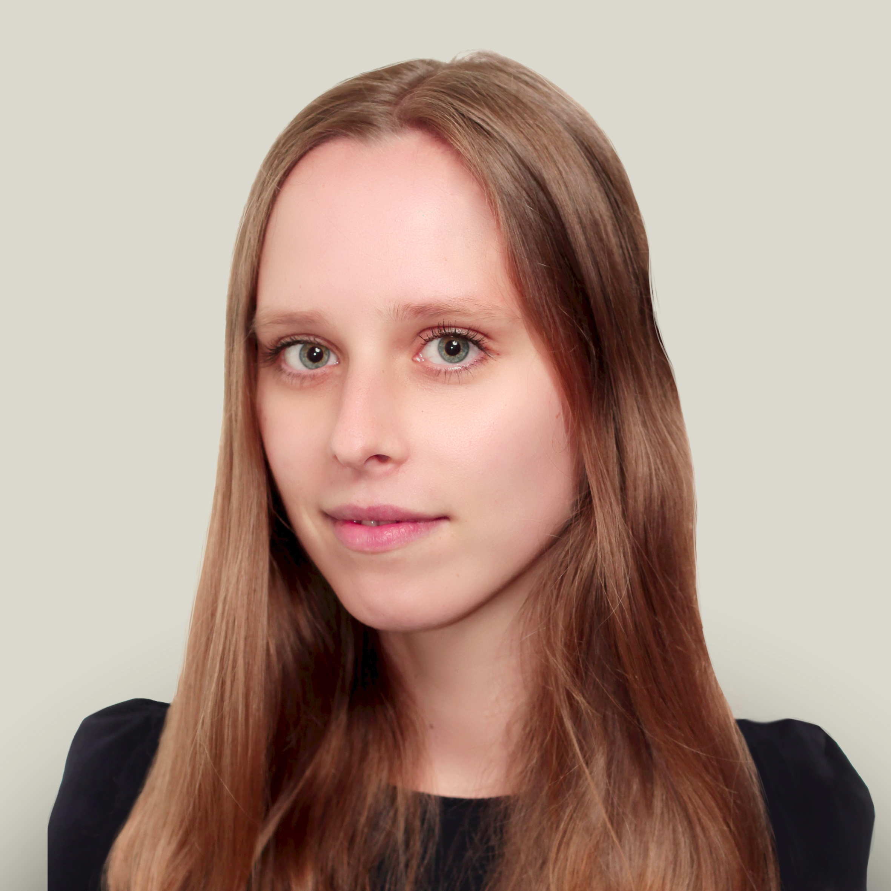

Contact
maria@appsilon.com
/in/mariagrycuk
appsilon.com

Slide 16
Example questions you can ask while gathering feedback[Extended version]
How often would you use this tool?
If you could add one more thing to the product what would it be?
If you would need to change one thing in the product what would it be?
Would you benefit from using this tool?

Slide 17
Good practices [Extended version]
Do not wait until the product is “good enough”
Limit the explanation to the minimum, do not describe anything without being asked
Ask users to perform business actions
Ask them to speak aloud about their thinking process and expectations
Focus on how they try to achieve the goal
It is best if the product owner is not involved
If possible use up-to-date, real data
Invite people who haven’t seen the tool before
Take your time
When asking about the general feedback ask open, not leading questions

